Slide 1
SOFTWARE ESTIMATION & SCHEDULING
THE MANAGEMENT SPECTRUM

Slide 2
3 P (PEOPLE, PRODUCT, PROCESS )
Effective software project management focuses on the three Ps: people, product, process. The order is not arbitrary.
The manager who forgets that software engineering work is an intensely human endeavor will never have success in project management.
A manager who fails to encourage comprehensive stakeholder communication early in the evolution of a product risks building an elegant solution for the wrong problem.
The manager who pays little attention to the process runs the risk of inserting competent technical methods and tools into a vacuum.
The manager who embarks without a solid project plan jeopardizes the success of the project.

Slide 3
PEOPLE
People build computer software, and projects succeed because well-trained, motivated people get things done.
All of us, from senior engineering vice presidents to the lowliest practitioner, often take people for granted.
Managers argue that people are primary, but their actions sometimes belie their words.
Let us examine the stakeholders who participate in the software process and the manner in which they are organized to perform effective software engineering.

Slide 4
PEOPLE (stakeholder)
The software process (and every software project) is populated by stakeholders who can be categorized into one of five constituencies:
1. Senior managers who define the business issues that often have a significant influence on the project.
2. Project (technical) managers who must plan, motivate, organize, and control the practitioners who do software work.
3. Practitioners who deliver the technical skills that are necessary to engineer a product or application.
4. Customers who specify the requirements for the software to be engineered and other stakeholders who have a peripheral interest in the outcome.
5. End users who interact with the software once it is released for production use.

Slide 5
PEOPLE(Team Leaders)
Project management is a people-intensive activity, competent practitioners often make poor team leaders.
They simply don’t have the right mix of people skills.
Edgemon states: “Unfortunately and all too frequently it seems, individuals just fall into a project manager role and become accidental project managers”
Model of Leadership : Motivation Organization, ideas and innovation
Four key traits: Problem Solving , Managerial identity, Acheivement, Influence and Team building

Slide 6
PEOPLE(software team)
There are almost as many human organizational structures for software development as there are organizations that develop.
The “best” team structure depends on the management style of your organization, the number of people who will populate the team and their skill levels, and the overall problem difficulty
seven project factorsthat should be considered when planning the structure of software engineering teams:

Slide 7
PEOPLE(software team)
Constantine [Con93] suggests four “organizational paradigms” for software engineering teams:
1. A closed paradigm structures a team along a traditional hierarchy of authority. Such teams can work well when producing software that is quite similar to past efforts, but they will be less likely to be innovative when working within the closed paradigm.
2. A random paradigm structures a team loosely and depends on individual initiative of the team members. When innovation or technological break through his required, teams following the random paradigm will excel. But such teams may struggle when “orderly performance” is required.
3. An open paradigm attempts to structure a team in a manner that achieves some of the controls associated with the closed paradigm but also much of the innovation that occurs when using the random paradigm. Work is performed collaboratively, with heavy communication and consensus-based decision making the trademarks of open paradigm teams. Open paradigm team structures are well suited to the solution of complex problems but may not perform as efficiently as other teams.

Slide 8
PEOPLE(software team)
4. A synchronous paradigm relies on the natural compartmentalization of a problem and organizes team members to work on pieces of the problem with little active communication among themselves.
Regardless of team organization, the objective for every project manager is to help create a team that exhibits cohesiveness.

Slide 9
PEOPLE(software team)
Many teams suffer from “team toxicity.” The major factor that foster a potentially toxic team environment
a frenzied work atmosphere,
high frustration that causes friction among team members,
a “fragmented or poorly coordinated” software process,
an unclear definition of roles on the software team, and
“continuous and repeated exposure to failure.”

Slide 10
PEOPLE(agile team)
Many software organizations advocate agile software development as an antidote to many of the problems that have plagued software project work.
The agile philosophy encourages customer satisfaction and early incremental delivery of software, small highly motivated project teams, informal methods, minimal software engineering work products, and overall development simplicity.
The small, highly motivated project team, also called an agile team, adopts many of the characteristics of successful software project teams and avoids many of the toxins that create problems.

Slide 11
PEOPLE(coordination and communication issue)
There are many reasons that software projects get into trouble. The scale of many development efforts is large, leading to complexity, confusion, and significant difficulties in coordinating team members
New software must communicate with existing software and conform to predefined constraints imposed by the system or product.
To accomplish this, mechanisms for formal and informal communication among team members and between multiple teams must be established.

Slide 12
Product
A software project manager is confronted with a dilemma at the very beginning of a software project.
Quantitative estimates and an organized plan are required, but solid information is unavailable.
A detailed analysis of software requirements would provide information necessary for estimates, but analysis often takes weeks or even months to complete.

Slide 13
Product(software scope)
The first software project management activity is the determination of software scope. Scope is defined by answering the following questions:
Context. How does the software to be built fi t into a larger system, product,or business context, and what constraints are imposed as a result of the context?
Information objectives. What customer-visible data objects are produced as output from the software? What data objects are required for input?
Function and performance. What function does the software perform to transform input data into output? Are any special performance characteristics to be addressed?.

Slide 14
Product(problem décomposition)
Problem decomposition, sometimes called partitioning or problem elaboration, is an activity that sits at the core of software requirements analysis
During the scoping activity no attempt is made to fully decompose the problem.
Decomposition is applied in two major areas:
(1) the functionality and content (information) that must be delivered and
(2) the process that will be used to deliver it.

Slide 15
process
The framework activities that characterize the software process are applicable to all software projects.
The problem is to select the process model that is appropriate for the software to be engineered by your project team.
Your team must decide which process model is most appropriate for
(1) the customers who have requested the product and the people who will do the work,
(2) the characteristics of the product itself, and
(3) the project environment in which the software team works.
When a process model has been selected, the team then defines a preliminary project plan based on the set of process framework activities.
Once the preliminary plan is established, process decomposition begins.

Slide 16
PROCESS AND PROJECT METRICS
When you can measure what you are speaking about and express it in numbers, you know something about it; but when you cannot measure, when you cannot express it in numbers, your knowledge is of a meager and unsatisfactory kind
Measurement can be applied to the software process with the intent of improving it on a continuous basis.
Measurement can be used throughout a software project to assist in estimation, quality control, productivity assessment, and project control.
Measurement can be used by software engineers to help assess the quality of work products and to assist in tactical decision making as a project proceeds

Slide 17
PROCESS AND PROJECT METRICS
Process metrics are collected across all projects and over long periods of time.
Project metrics enable a software project manager to
(1) assess the status of an ongoing project,
(2) track potential risks,
(3) uncover problem areas before they go “critical,”
(4) adjust work flow or tasks, and
(5) evaluate the project team’s ability to control quality of software work products.
Measures that are collected by a project team and converted into metrics for use during a project can also be transmitted to those with responsibility for software process improvement.

Slide 18
PROCESS AND PROJECT METRICS

Slide 19
software metrics etiquette
Use common sense and organizational sensitivity when interpreting metrics data.
Provide regular feedback to the individuals and teams who collect measures and metrics.
Don’t use metrics to appraise individuals.
Work with practitioners and teams to set clear goals and metrics that will be used to achieve them.
Never use metrics to threaten individuals or teams.
Metrics data that indicate a problem area should not be considered “negative.” These data are merely an indicator for process improvement.
Don’t obsess on a single metric to the exclusion of other important metrics.

Slide 20
PROJECT METRICS
Software process metrics are used for strategic purposes, software project measures are tactical.
Project metrics and the indicators derived from them are used by a project manager and a software team to adapt project work flow and technical activities.
The first application of project metrics on most software projects occurs during estimation.
Metrics collected from past projects are used as a basis from which effort and time estimates are made for current software work.
As a project proceeds, measures of effort and calendar time expended are compared to original estimates (and the project schedule). The project manager uses these data
to monitor and control progress

Slide 21
PROJECT METRICS
As technical work commences, other project metrics begin to have significance.
Production rates represented in terms of models created, review hours, function points, and delivered source lines are measured.
In addition, errors uncovered during each software engineering task are tracked.
As the software evolves from requirements into design, technical metrics are collected to assess design quality and to provide indicators that will influence the approach taken to code generation and testing.

Slide 22
PROJECT METRICS
The intent of project metrics is twofold.
First, these metrics are used to minimize the development schedule by making the adjustments necessary to avoid delays and mitigate potential problems and risks.
Second, project metrics are used to assess product quality on an ongoing basis and, when necessary, modify the technical approach to improve quality.
As quality improves, defects are minimized, and as the defect count goes down, the amount of rework required during the project is also reduced. This leads to a reduction in overall project cost.

Slide 23
SOFTWARE MEASUREMENT
There are two approach to this : Direct Measure ( the length of bolt) and Indirect Measure (the quality of bolt produced, measured by counting result)
Direct measures of the software process include cost and effort applied.
Direct measures of the product include lines of code (LOC) produced, execution speed, memory size, and defects reported over some set period of time.
Indirect measures of the product include functionality, quality, complexity, efficiency, reliability, maintainability, and many other factors
The cost and effort required to build software, the number of lines of code produced, and other direct measures are relatively easy to collect, as long as specific conventions for measurement are established in advance.

Slide 24
Size oriented METRICS
Size-oriented software metrics are derived by normalizing quality and/or productivity measures by considering the size of the software that has been produced.
If a software organization maintains simple records, a table of size-oriented measures can be created

Slide 25
Size oriented METRICS
In order to develop metrics that can be assimilated with similar metrics fromother projects, you can choose lines of code as a normalization value.
From the rudimentary data contained in the table, a set of simple size-oriented metrics can be developed for each project:
• Errors per KLOC (thousand lines of code)
• Defects per KLOC
• $ per KLOC
• Pages of documentation per KLOC
In addition, other interesting metrics can be computed:
• Errors per person-month
• KLOC per person-month
• $ per page of documentation

Slide 26
Function oriented METRICS
Function-oriented software metrics use a measure of the functionality delivered by the application as a normalization value.
The most widely used function oriented metric is the function point (FP). Computation of the function point is based on characteristics of the software’s information domain and complexity.
Using historical data, the FP metric can then be used to
estimate the cost or effort required to design, code, and test the software
predict the number of errors that will be encountered during testing
forecast the number of components and/or the number of projected source lines in the implemented system.

Slide 27
FUNCTION POINT METRICS
Function points are derived using an empirical relationship based on countable (direct) measures of software’s information domain and qualitative assessments of software complexity
Information domain values are defined in the following manner:
Number of external inputs (EIs).
Number of external outputs (EOs)
Number of external inquiries (EQs)
Number of internal logical fi les (ILFs)
Number of external interface fi les (EIFs).

Slide 28
FUNCTION POINT METRICS

Slide 29
FUNCTION POINT METRICS
To compute function points (FP), the following relationship is used:
where count total is the sum of all FP entries obtained from Figure
The F i ( i = 1 to 14) are value adjustment factors (VAF) based on responses to the following questions
1. Does the system require reliable backup and recovery?
2. Are specialized data communications required to transfer information to or from the application?
3. Are there distributed processing functions?
4. Is performance critical?

Slide 30
Function oriented METRICS
5. Will the system run in an existing, heavily utilized operational environment?
6. Does the system require online data entry?
7. Does the online data entry require the input transaction to be built over multiple screens or operations?
8. Are the ILFs updated online?
9.Are the inputs, outputs, files, or inquiries complex?
10. Is the internal processing complex?
11. Is the code designed to be reusable?
12. Are conversion and installation included in the design?

Slide 31
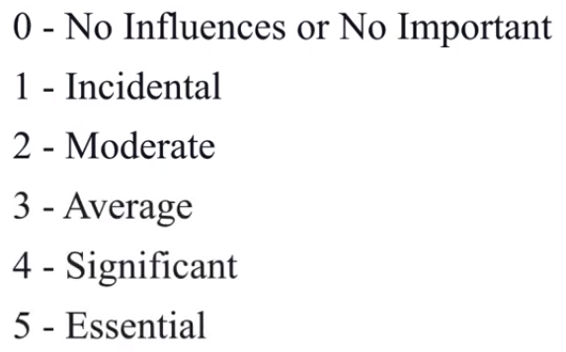
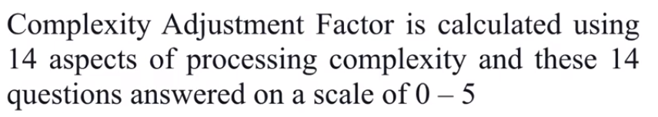
Function oriented METRICS
13. Is the system designed for multiple installations in different organizations?
14. Is the application designed to facilitate change and ease of use by the user?
Each of these questions is answered using an ordinal scale that ranges from 0 (not important) to 5 (absolutely essential). The constant values in Equation and the weighting factors that are applied to information domain counts are determined empirically.

Slide 32
Function oriented METRICS

Slide 33
Function oriented METRICS

Slide 34

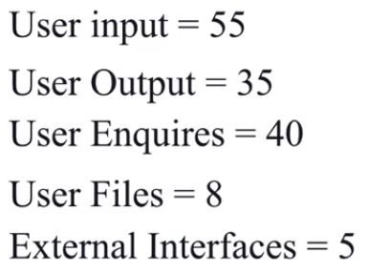
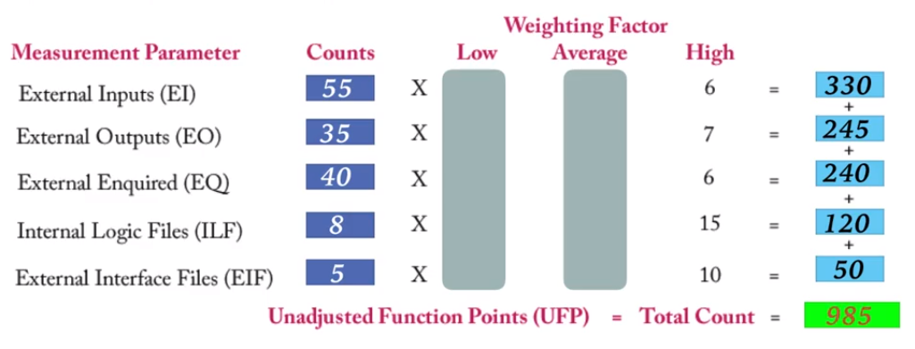

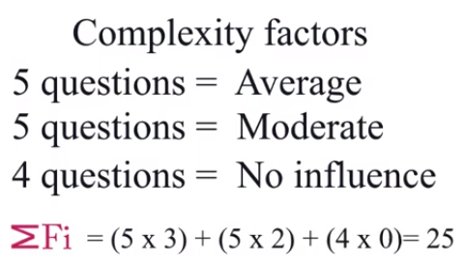
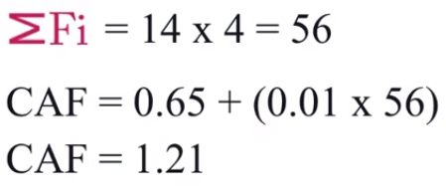
Function oriented METRICS

Slide 35
Loc and fp metrics
The function point, like the LOC measure, is controversial.
FP is programming language–independent, making it ideal for applications using conventional and nonprocedural languages
It is based on data that are more likely to be known early in the evolution of a project, making FP more attractive as an estimation approach.
The relationship between lines of code and function points depends upon the programming language that is used to implement the software and the quality of the design

Slide 36
Function oriented METRICS

Slide 37
Empirical estimation model
An estimation model for computer software uses empirically derived formulas to predict effort as a function of LOC or FP.
The empirical data that support most estimation models are derived from a
limited sample of projects
No estimation model is appropriate for all classes of software and in all development environments.
An estimation model should be calibrated to reflect local conditions.
The model should be tested by applying data collected from completed projects, plugging the data into the model, and then comparing actual to predicted results.

Slide 38
Object oriented METRICS
Conventional software project metrics (LOC or FP) can be used to estimate object-oriented software project
These metrics do not provide enough granularity for the schedule and effort adjustments that are required as you iterate through an evolutionary or incremental process.
The following set of metrics are used for Object oriented
Number of scenario scripts.
Number of key classes
Number of support classes.
Average number of support classes per key class.
Number of subsystems

Slide 39
Function oriented METRICS
Funct

Slide 40
Function oriented METRICS
Funct

Slide 41
Function oriented METRICS
Funct

Slide 42
Function oriented METRICS
Funct

Slide 43
Function oriented METRICS
Funct

Slide 44
Function oriented METRICS
Funct

Slide 45
Function oriented METRICS
Funct

Slide 46
Function oriented METRICS
Funct

Slide 47
Function oriented METRICS
Funct

Slide 48
Function oriented METRICS
Funct

Slide 49
Function oriented METRICS
Funct

Slide 50
Function oriented METRICS
Funct

Slide 51
Function oriented METRICS
Funct

Slide 52
Function oriented METRICS
Funct

Slide 53
Function oriented METRICS
Funct

Slide 54
Function oriented METRICS
Funct

Slide 55
Function oriented METRICS
Funct

Slide 56
Function oriented METRICS
Funct

Slide 57
Function oriented METRICS
Funct

Slide 58
Function oriented METRICS
Funct

Slide 59
Function oriented METRICS
Funct

Slide 60
Function oriented METRICS
Funct

Slide 61
Function oriented METRICS
Funct

Slide 62
Function oriented METRICS
Funct

Slide 63
Function oriented METRICS
Funct

Slide 64
Function oriented METRICS
Funct

Slide 65
Function oriented METRICS
Funct

Slide 66
Function oriented METRICS
Funct

Slide 67
Function oriented METRICS
Funct

Slide 68
Function oriented METRICS
Funct

Slide 69
Function oriented METRICS
Funct

Slide 70
Function oriented METRICS
Funct

Slide 71
Function oriented METRICS
Funct

